Slide 1




Sarvajanik Education Society
Sarvajanik College of Engineering and Technology, Surat.
Department of Computer Applications
Academic Year: 2025– 26
A Project On
“Self Checkout System”
Presented By
HariKrushna (ET25IMCA008)
Aum (ET25IMCA039)
Yash (ET25IMCA044)
IMCA I Sem-2
Under the Guidance of
Prof. Veer Pachchigar

Slide 2
Programme: IMCA I Sem-2
AYH MART - CHECKOUT SYSTEM
Presented By:
HariKrushna - ET25IMCA008
Aum - ET25IMCA039
Yash - ET25IMCA044

Slide 3
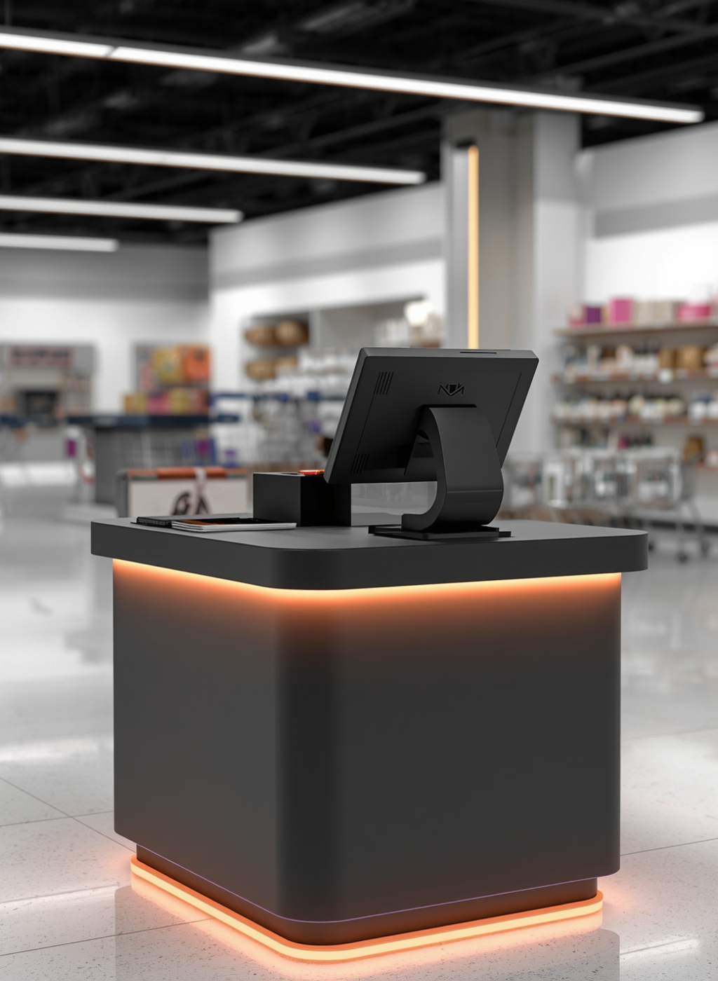
AGENDA
1.Project Abstract
2.Objective
3.System Description
4.Screenshots
5.Test Cases
6.References

Slide 4
01
PROJECT ABSTRACT
AYH MART CHECKOUT SYSTEM
AYH Mart is a console-based checkout system developed in C, designed for a retail store. It allows customers to independently browse products, add items to a cart, and complete purchases via Cash or UPI QR Code.
The system supports three user roles - Customer, Staff, and Admin - each with a dedicated portal. Key features include product inventory management, a tiered membership discount program (Silver, Gold, Platinum), customer account management, and a detailed sales reporting module.
All data is managed in-memory using C structures, making the system
lightweight, efficient, and fully functional as a retail management
solution.

Slide 5
02
PROJECT OBJECTIVES
01
C-Based System
Create a system using C programming language
To develop a console-based retail checkout system using C
To implement role-based access (Admin, Staff, Customer)
To design an efficient inventory management system
To enable customer self-checkout functionality
To provide multiple payment options (Cash and UPI QR Code)
To implement a membership system with tiered discounts (Silver, Gold, Platinum)
To manage customer accounts and purchase records
To generate sales reports and analytics
To build a simple, fast, and user-friendly system using modular programming
02
Implement user roles for customers and staff
Role-based Access
03
Streamline inventory tracking and management processes
Inventory Management

Slide 6

SYSTEM DESCRIPTION
LANGUAGES, LIBRARIES, DATA STRUCTURES AND FUNCTIONS
Language & Platform
Libraries used
C (Standard C)
Windows Console App
GCC / Dev-C++
stdio.h — I/O operations
string.h — String handling
ctype.h — Char classification
stdlib.h — System calls, exit()
windows.h — UTF-8 / Unicode support
Architecture Menu-driven, modular function design.
03
5 core modules:
Inventory
Members
Customer Self-Checkout
Sales Reports
Customer Accounts

Slide 7
04
SCREENSHOTS

Slide 8
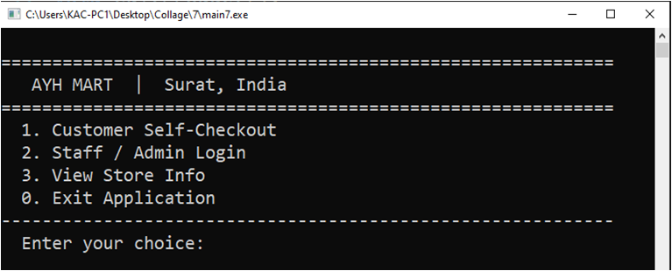
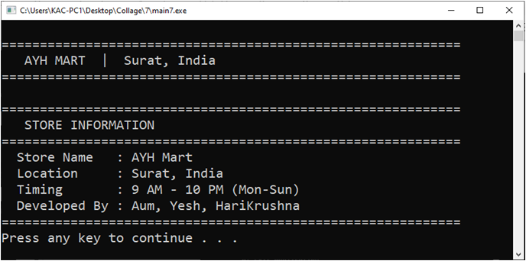
1. MAIN MENU
2.VIEW STORE INFO

Slide 9
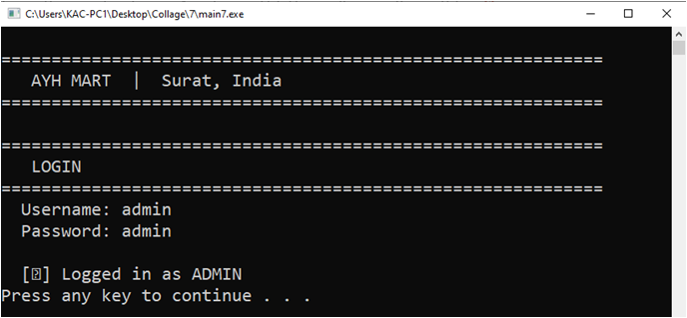
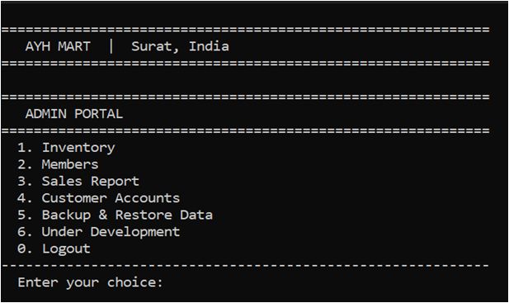
3. ADMIN LOGIN
4. ADMIN PORTAL

Slide 10
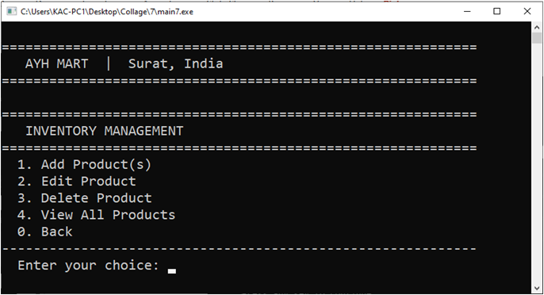
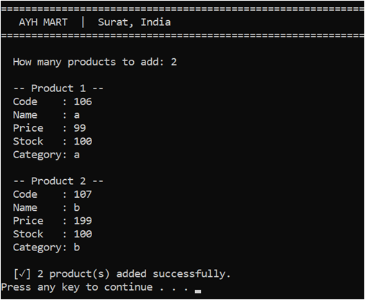
5. INVENTORY MANAGEMENT
6. ADD PRODUCT(S)

Slide 11
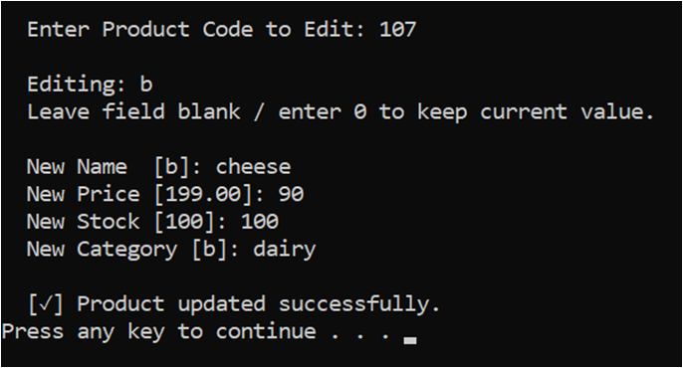
7. INVENTORY MANAGEMENT
8. EDIT PRODUCT

Slide 12
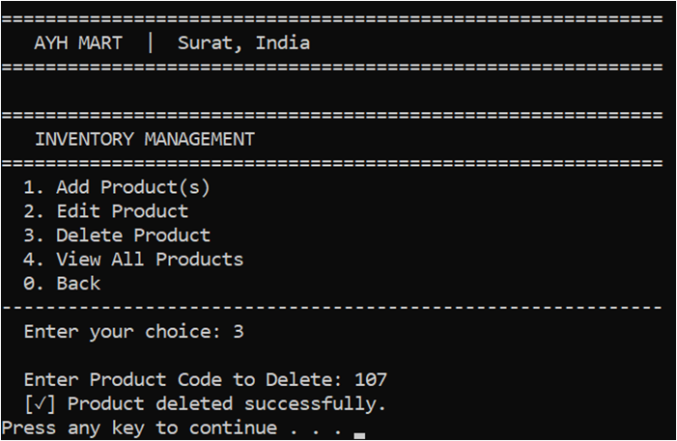
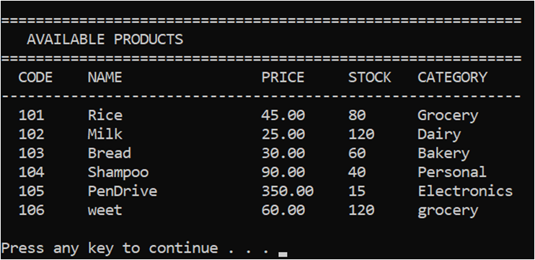
9. DELETE PRODUCT
10. VIEW ALL PRODUCT

Slide 13
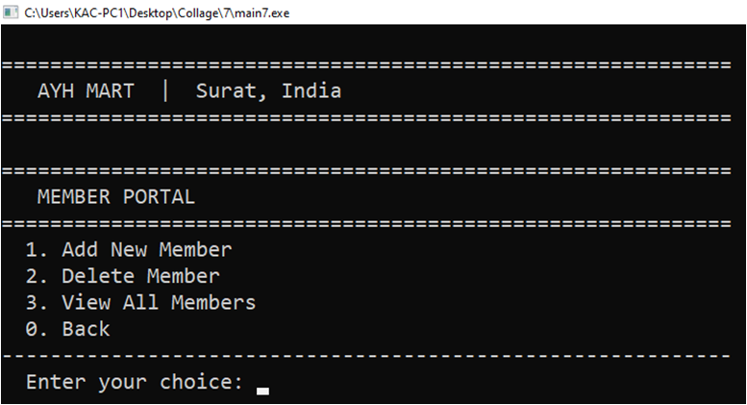
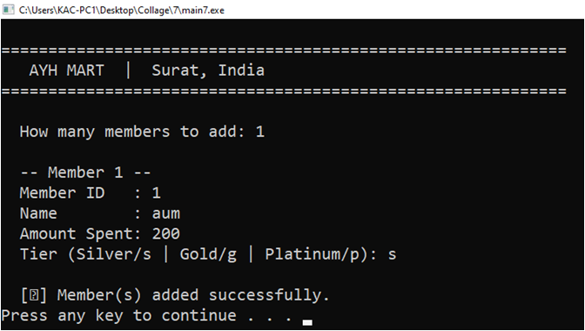
11. MEMBER PORTAL
12. ADD NEW MEMBER

Slide 14
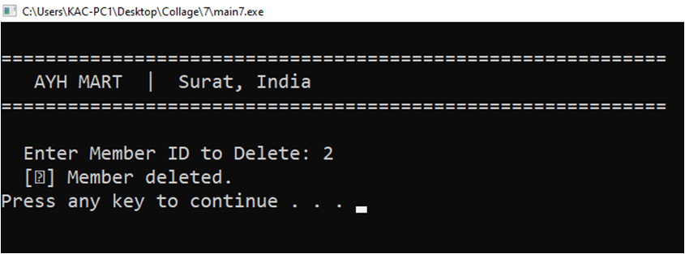
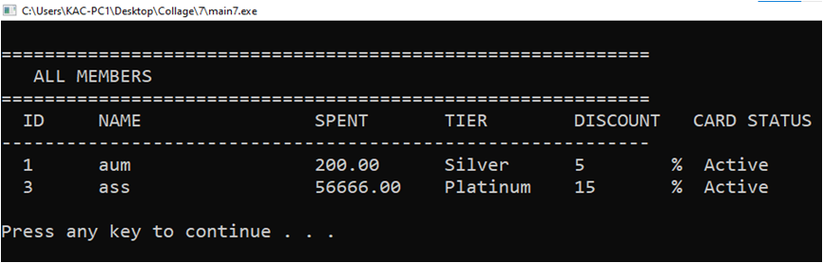
13. DELETE MEMBER
14. VIEW ALL MEMBER

Slide 15
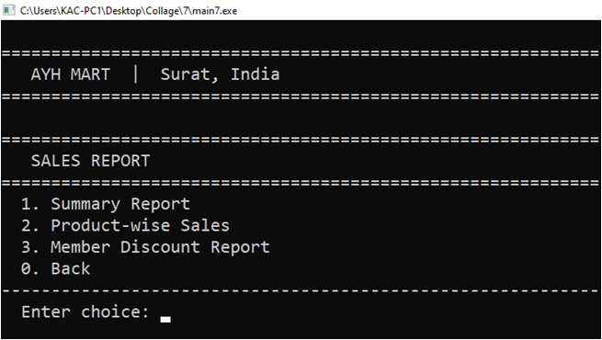
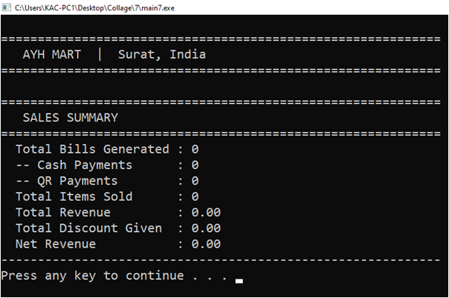
15. SALES REPORT
16. SALE SUMMARY

Slide 16
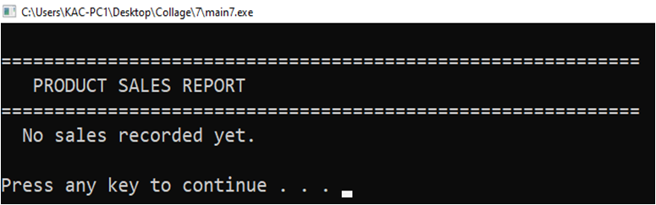
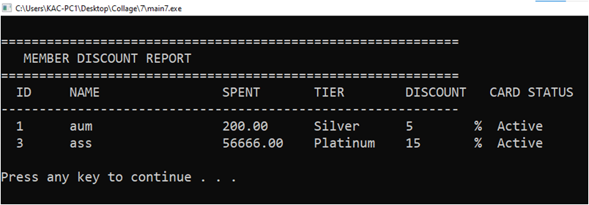
17. PRODUCT SALES REPORT
18. MEMBER DISCOUNT REPORT

Slide 17
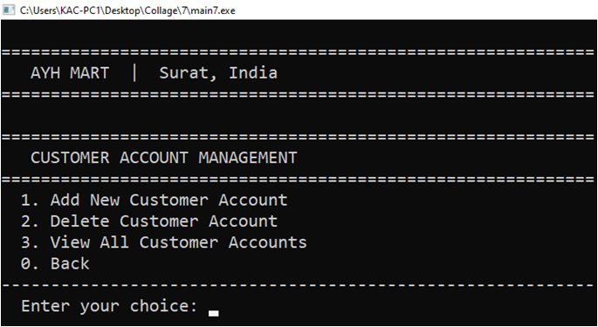
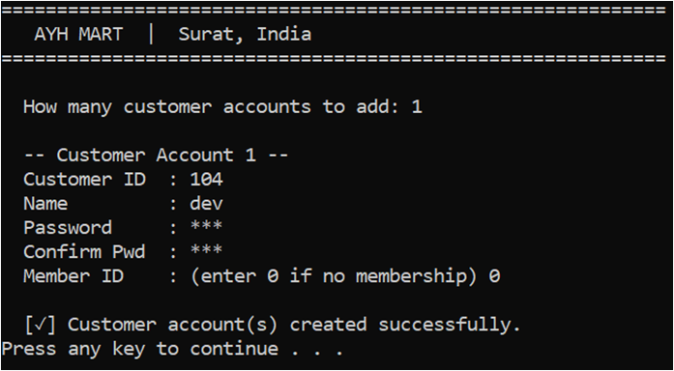
19. CUSTOMER ACCOUNT MANAGEMENT
20. ADD NEW CUSTOMER ACCOUNT

Slide 18
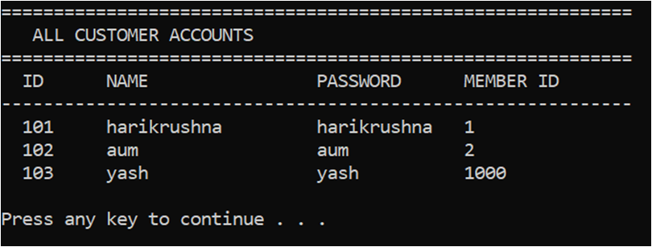
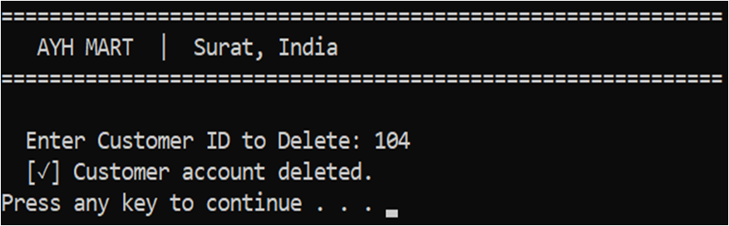
21. VIEW ALL CUSTOMER
22. DELETE CUSTOMER

Slide 19
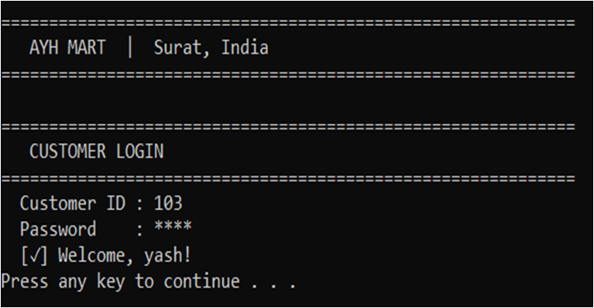
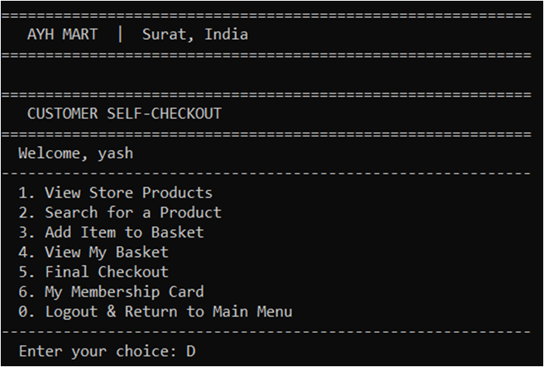
23. CUSTOMER LOGIN
24. CUSTOMER PORTAL

Slide 20
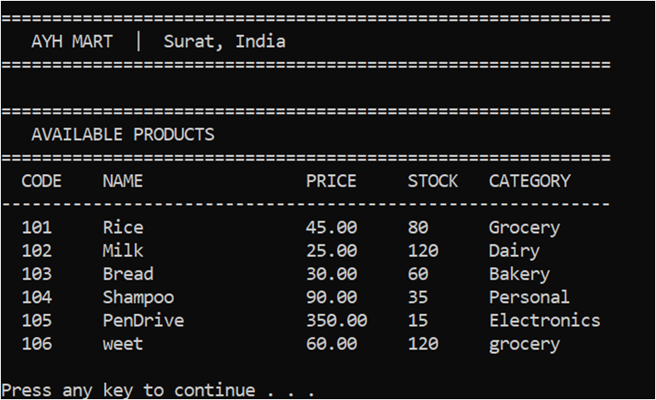
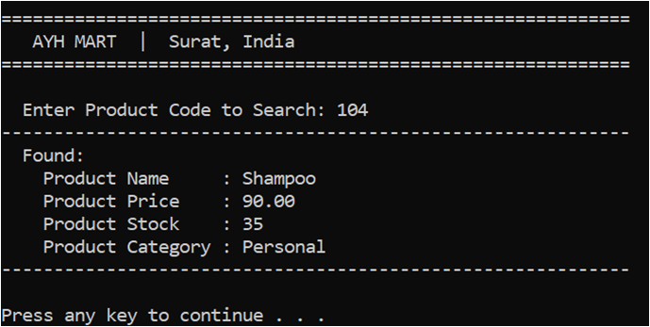
25. VIEW PRODUCT
26. SEARCH PRODUCT

Slide 21
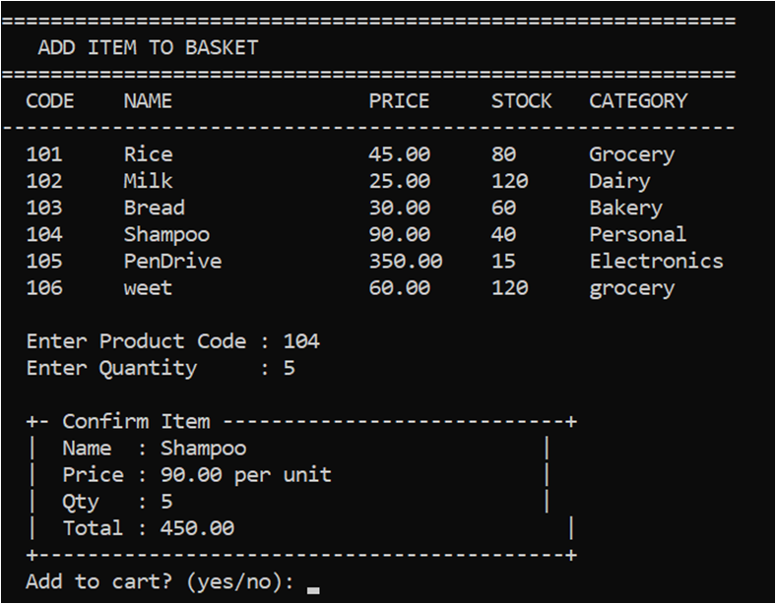
27. ADD ITEM TO BASKET

Slide 22
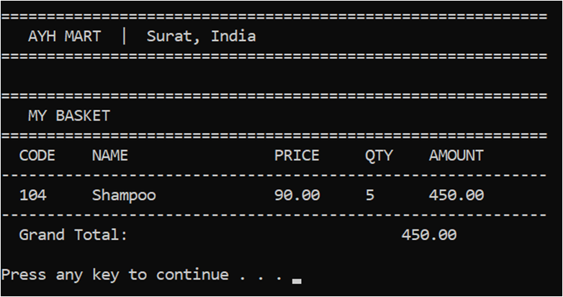
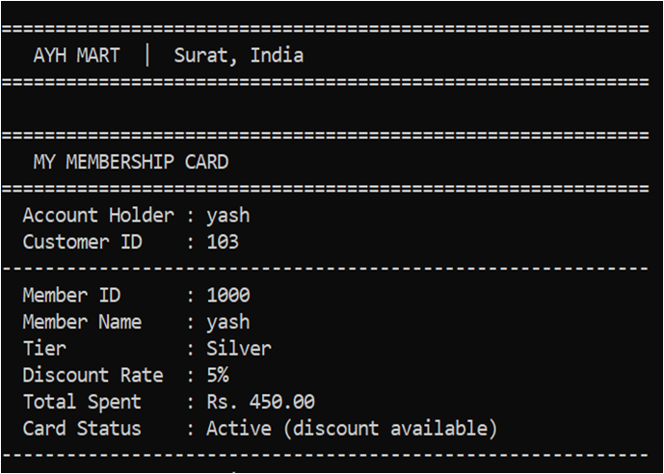
28. VIEW BASKET
29. VIEW MEMBERSHIP CARD

Slide 23
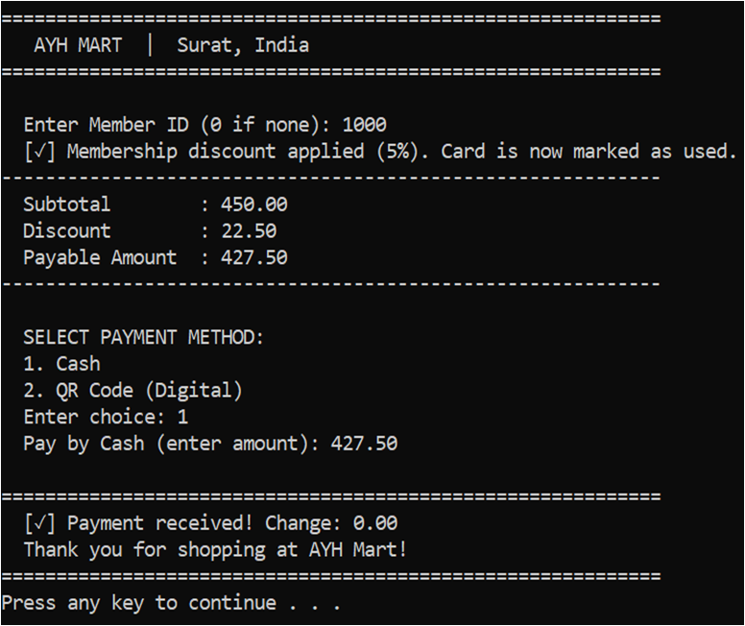
30. CHECK-OUT VIA CASH

Slide 24
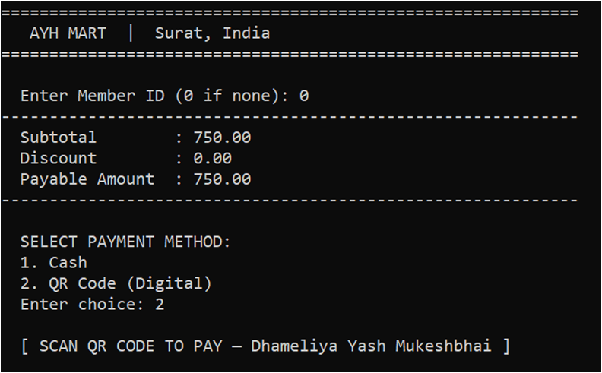
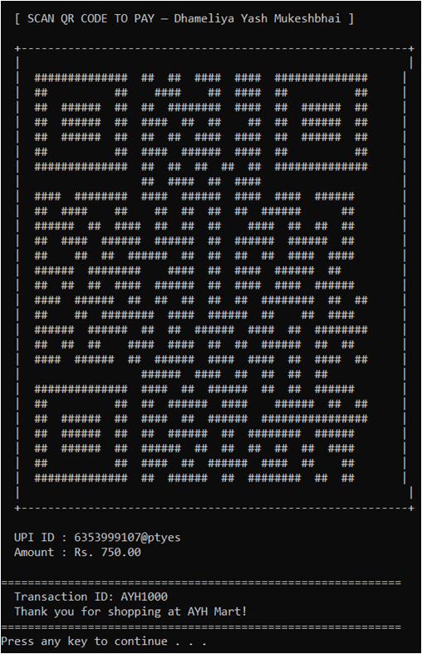
31. CHECK-OUT VIA QR CODE

Slide 25
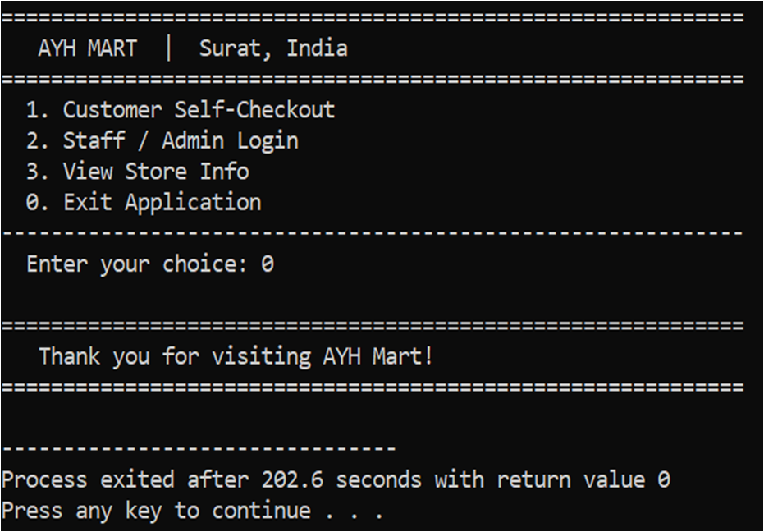
32. EXIT APPLICATION

Slide 26
05
TEST CASES

Slide 27
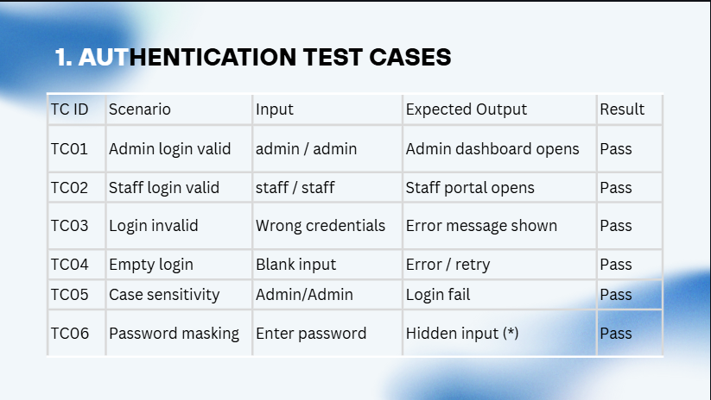

Slide 28
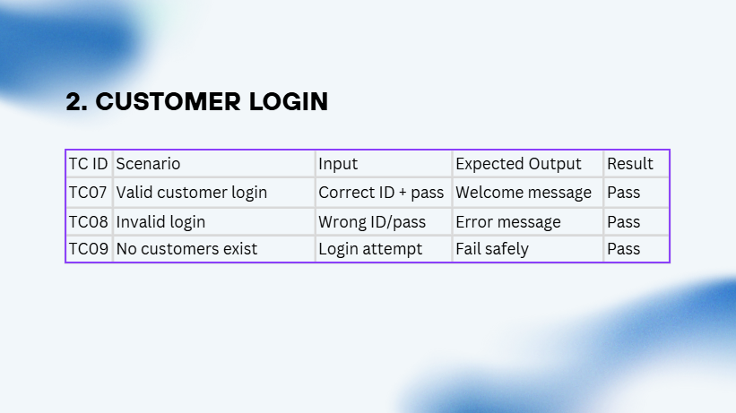

Slide 29
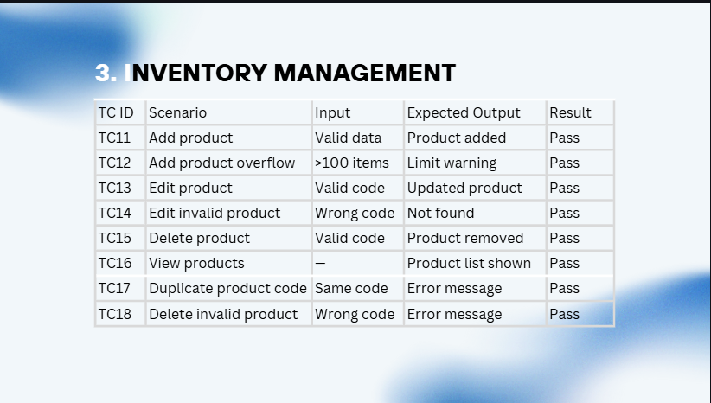

Slide 30
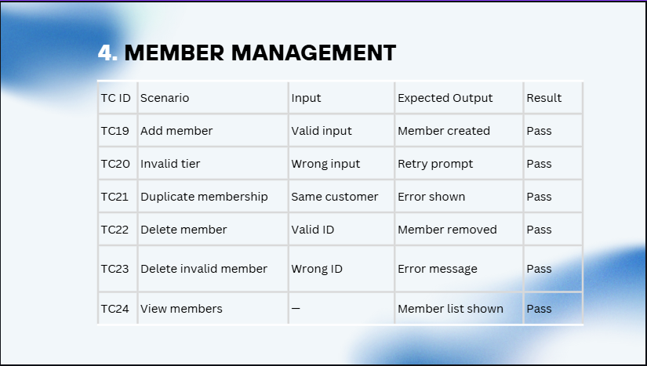

Slide 31
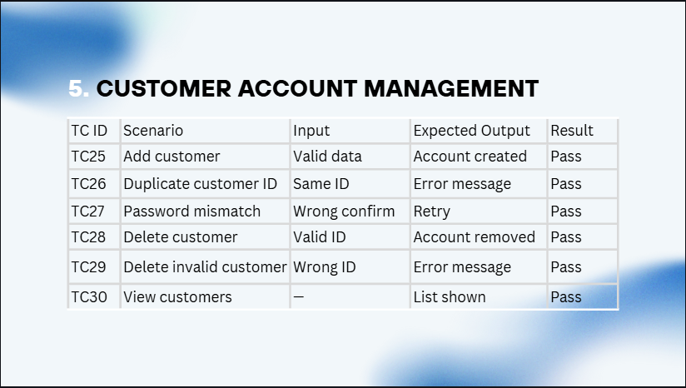

Slide 32
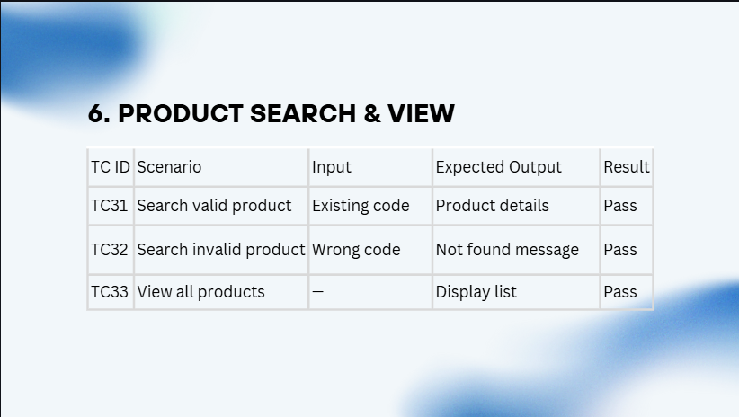

Slide 33
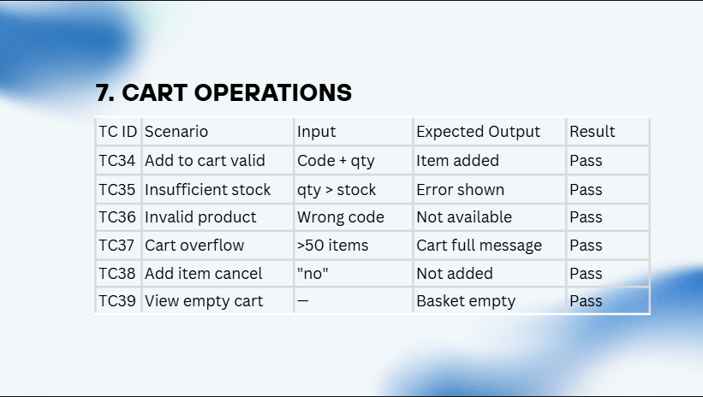

Slide 34
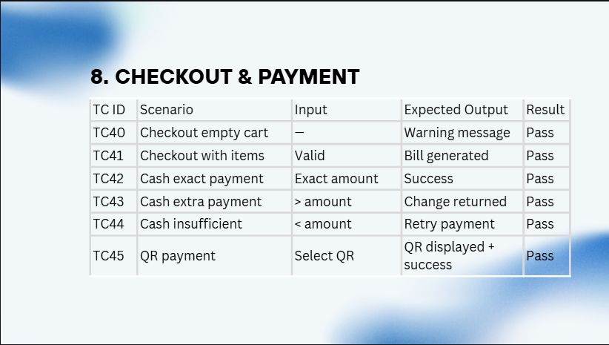

Slide 35
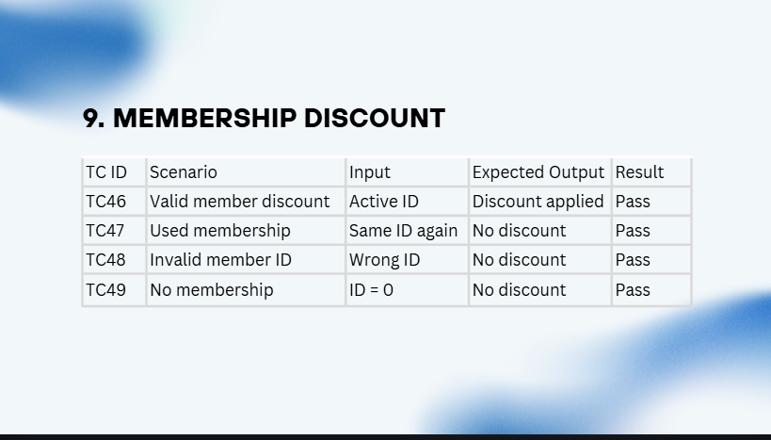

Slide 36
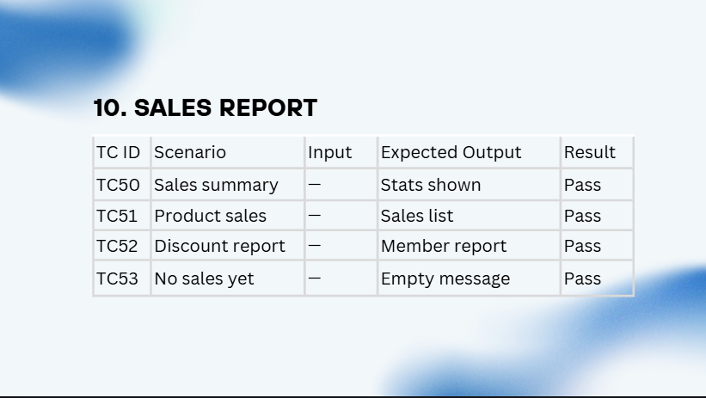

Slide 37
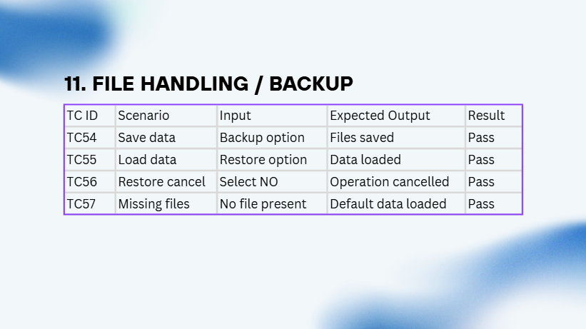

Slide 38



06
https://www.gofrugal.com/retail/?ref=common-header
REFERENCES
https://www.zoho.com/in/inventory/features/
OFFLINE STORE

Slide 39
THANK YOU

